Slide 1
INTERNSHIP PROGRAM
TATA MOTORS
DURATION:22 JULY 2025 TO 22 AUGUST 2025
PRESENTED BY:
BHOOMIKA PANDEY, DRISHTI RAWAT
UNIVERSITY /COLLEGE:
WOMEN’S INSTITUTE OF TECHNOLOGY , VEER MADHO SINGH BHANDARI
UTTARAKHAND TECHNICAL UNIVERSITY(UTU),DEHRADUN
SUBMITTED TO:
NAVEEN KUMAR(CMS PURCHASE)

Slide 2
Sales & Procurement Forecasting using Machine Learning and Python
XGBOOST MODEL
(MACHINE LEARNING)

Slide 3
AGENDA
Introduction
Business Problem
Data Used
Forecasting Models
Code Used For Both Models
Model Evaluation Result
Results & Accuracy
Conclusion

Slide 4
Introduction
Forecasting is predicting future demand or trends using historical data.
Accurate forecasts help plan procurement efficiently, reduce costs, and avoid stock-outs.
This project analyzes procurement data (2022–2024) to predict demand for 2025.

Slide 5
Business Problem (Amount & Month Focus)
Fluctuating Monthly Demand: Material purchase amounts vary each month, making it hard to predict future requirements.
Risk of Overstocking or Understocking: Without accurate monthly forecasts, some months may have excess stock while others face shortages.
Cost Implications: Unplanned high procurement amounts in certain months can tie up capital and increase storage costs.
Planning Challenges: Manual tracking of monthly amounts is time-consuming and prone to errors.

Slide 6
Data Used
Dataset: 2022–2024 (training), 2025 (testing).
Fields: Amount Value, Month, Amount In LC , Amount
Preprocessing: cleaning, missing values.
DOUBLE CLICK TO ACCESS
THE DATA USED

Slide 7
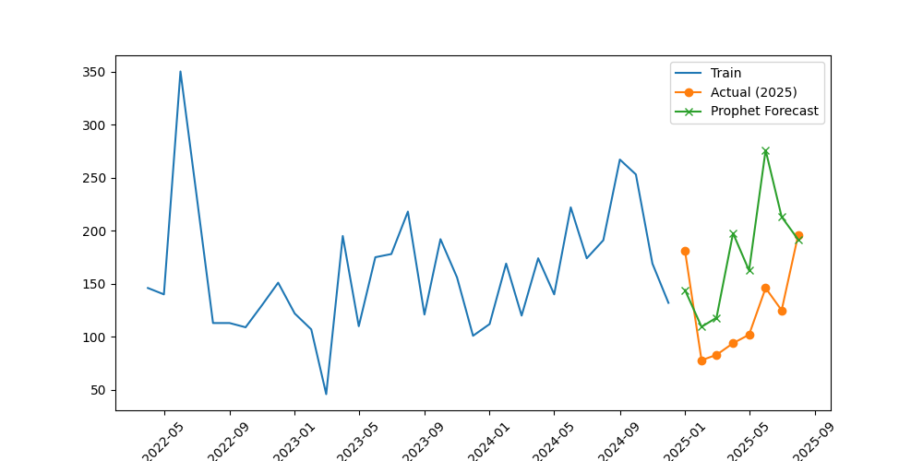
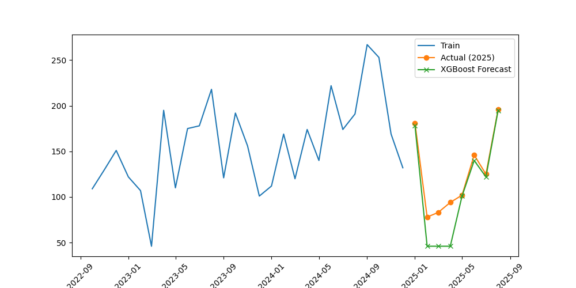
Forecasting Models
1. PROPHET MODEL 2. XGBOOST MODEL
Prophet is a time series forecasting model designed for business data. It works well when:
Data has strong seasonal effects (daily, weekly, yearly).
Data has holidays/events affecting trends.
Missing data points are present.
Non-linear trends exist.
XGBoost is a machine learning model based on gradient boosting of decision trees. It’s not a traditional time series model, but you can use it for forecasting by creating lag features.
Gradient boosting builds models sequentially:
Start with a base model (simple prediction like mean value).
Train a new model to correct the errors of the previous model.
Repeat, adding models to minimize prediction error.

Slide 8
CODE USED FOR PROPHET MODEL
import pandas as pd
import numpy as np
from prophet import Prophet
from sklearn.metrics import mean_absolute_error, mean_squared_error
import matplotlib.pyplot as plt
df = pd.read_excel("file(3).xlsx")
df['MONTH'] = pd.to_datetime(df['MONTH'], format='%b-%y')
df = df.sort_values('MONTH').reset_index(drop=True)
df = df.rename(columns={'MONTH':'ds', 'AMOUNT VALUE':'y'})
df['year'] = df['ds'].dt.year
train = df[df['year'].between(2022,2024)].copy()
test = df[df['year']==2025].copy()
model = Prophet(yearly_seasonality=True, daily_seasonality=False, weekly_seasonality=False)
model.fit(train)
future_dates = pd.date_range(start=train['ds'].min(), end='2028-12-01', freq='MS')
future = pd.DataFrame({'ds': future_dates})
forecast = model.predict(future)
forecast_test = forecast[forecast['ds'].isin(test['ds'])].copy()
y_test = test['y'].values
y_pred = forecast_test['yhat'].values
mae = mean_absolute_error(y_test, y_pred)
rmse = np.sqrt(mean_squared_error(y_test, y_pred))
mape = np.mean(np.abs((y_test - y_pred) / y_test)) * 100
print(f"MAE: {mae:.2f}, RMSE: {rmse:.2f}, MAPE: {mape:.2f}%")
plt.figure(figsize=(12,5))
plt.plot(train['ds'], train['y'], label='Train', marker='o')
plt.plot(test['ds'], y_test, label='Actual (2025)', marker='o')
plt.plot(test['ds'], y_pred, label='Forecast (Prophet)', marker='x')
plt.title("Line Chart: Actual vs Forecast")
plt.xlabel("Month")
plt.ylabel("Amount")
plt.xticks(rotation=45)
plt.legend()
plt.grid(True)
plt.tight_layout()
plt.show()
OUTPUT

Slide 9
CODE USED FOR XGBOOST MODEL
import pandas as pd
import numpy as np
from xgboost import XGBRegressor
from sklearn.metrics import mean_absolute_error, mean_squared_error
from sklearn.model_selection import train_test_split
import matplotlib.pyplot as plt
df = pd.read_excel("file(3).xlsx")
df['MONTH'] = pd.to_datetime(df['MONTH'], format='%b-%y')
df = df.sort_values('MONTH').reset_index(drop=True)
df['year'] = df['MONTH'].dt.year
df['month_num'] = df['MONTH'].dt.month
for lag in [1, 2, 3, 6]:
df[f'lag_{lag}'] = df['AMOUNT VALUE'].shift(lag)
df['roll_3'] = df['AMOUNT VALUE'].shift(1).rolling(window=3).mean()
df['roll_6'] = df['AMOUNT VALUE'].shift(1).rolling(window=6).mean()
df = df.dropna().reset_index(drop=True)
train = df[df['year'] <= 2024]
test = df[df['year'] == 2025]
X_train = train.drop(columns=['AMOUNT VALUE','MONTH'])
y_train = train['AMOUNT VALUE']
X_test = test.drop(columns=['AMOUNT VALUE','MONTH'])
y_test = test['AMOUNT VALUE']
model = XGBRegressor(n_estimators=500, learning_rate=0.05, max_depth=5, random_state=42)
model.fit(X_train, y_train)
y_pred = model.predict(X_test)
mae = mean_absolute_error(y_test, y_pred)
rmse = np.sqrt(mean_squared_error(y_test, y_pred))
mape = np.mean(np.abs((y_test - y_pred) / y_test)) * 100
print(f"MAE: {mae:.2f}, RMSE: {rmse:.2f}, MAPE: {mape:.2f}%")
plt.figure(figsize=(10,5))
plt.plot(train['MONTH'], train['AMOUNT VALUE'], label="Train")
plt.plot(test['MONTH'], y_test.values, label="Actual (2025)", marker='o')
plt.plot(test['MONTH'], y_pred, label="XGBoost Forecast", marker='x')
plt.legend()
plt.xticks(rotation=45)
plt.show()
OUTPUT

Slide 10
Model Evaluation Result
Metric | Benchmark (Acceptable Range) | Prophet Result | XGBoost Result | Conclusion
MAE (Mean Absolute Error) | ≤ 20–30 units | 61 ❌ | 16 ✅ | XGBoost fits within limit
RMSE (Root Mean Squared Error) | ≤ 30–40 units | 73 ❌ | 24 ✅ | XGBoost performs very well
MAPE (Mean Absolute Percentage Error) | ≤ 20% | 54% ❌ | 18% ✅ | XGBoost is accurate

Slide 11
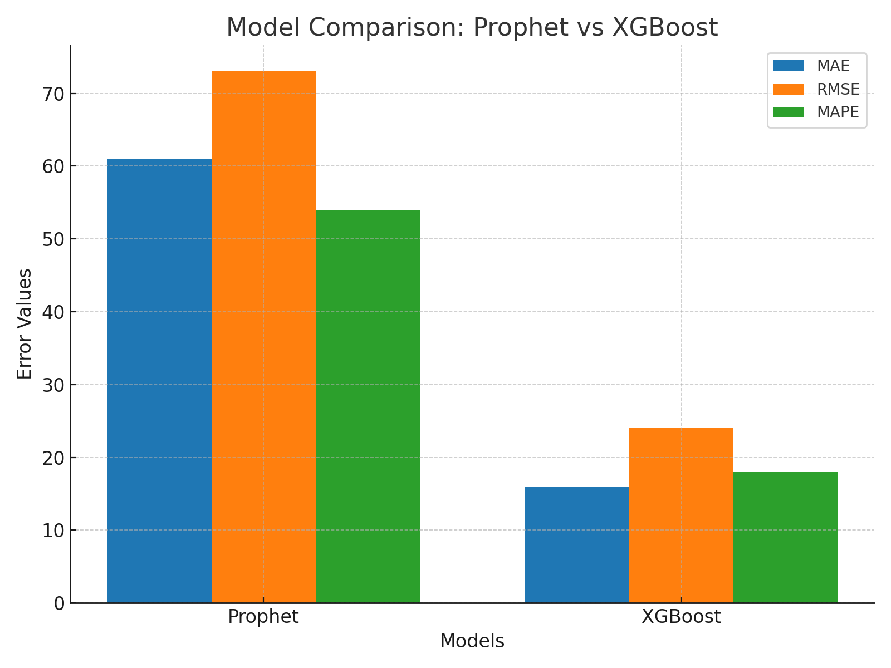
Result and Accuracy
MODEL | MEAN ABSOLUTE ERROR(MAE) | ROOT MEAN SQUARE ERROR (RMSE) | MEAN ABSOLUTE PERCENTAGE ERROR (MAPE)
XG BOOST MODEL (MACHINE LEARNING) | 16% | 24% | 18%
PROPHET MODEL (TIME SERIES MODEL) | 61% | 73% | 54%

Slide 12
Conclusion
Two forecasting models were evaluated: Prophet and XGBoost.
Prophet gave higher errors (MAE ≈ 61, RMSE ≈ 73, MAPE ≈ 54%)
XGBoost performed very well than Prophet with much lower errors (MAE ≈ 16, RMSE ≈ 24, MAPE ≈ 18%).
This shows that XGBoost is more robust, accurate, and reliable for capturing the patterns and seasonality in the data compared to Prophet.
Hence, XGBoost is recommended as the primary forecasting model for future business use cases.

Slide 13
THANKYOU!!

